Slide 3
Notes:
The term “harassment” includes, but is not limited to, jokes, slurs, or other verbal, graphic, or physical conduct relating to a person’s race, color, sex, religion, national origin, citizenship, age or disability.
Sexual Harassment can be when a person, regardless of gender, is asked to engage in sexual activity as a condition of that person’s employment

Slide 4
Notes:
Any type of repeated and unwanted physical contact is definitely sexual harassment. Avoid physical contact with co-workers, unless they tell you it is okay. In the US, it is not common to greet co-workers with hugs or kisses. It is appropriate to shake hands and respect their personal boundaries.
NOTES on Unwanted Physical Contact:
Preventing Movement – a person prevents another person from leaving a room (i.e. an office, a break room, a housekeeping closet, a bedroom in an employee housing), asking them for sexual favors if they want to leave a space
Repeatedly Standing or sitting close to someone – This creates a pattern of violating physical boundaries / space under physical conduct. (i.e. standing too close, moving forward into someone’s personal space after they step back, and doing this repeatedly and coupled with other behaviors on the list); Culturally, people’s comfort with physical proximity to another person can vary and result in misunderstandings between people from two different countries.

Slide 5
Notes:
What you say can also be sexual harassment. Unwanted sexual comments, jokes, or threats are all forms of sexual harassment. In addition, negative comments about any group of people, such as women, members of the LGBTQ community or people of a certain religious group can be considered harassment.

Slide 6
Notes:
Even sexual looks or gestures can be considered sexual harassment if it makes a person feel scared or intimidated. If your boss or another employee makes you uncomfortable by behaving in any of these ways, it is important to tell someone you trust and call your program sponsor so they can help you.

Slide 7
Notes:
What is wrong in these pictures?
Touching people in sexual ways
Preventing someone the freedom to move; Blocking someone so they can’t move
Tying work to sexual or romantic requests
Showing people inappropriate or sexual jokes, images, movies

Slide 8
Notes:
Looking people up and down in sexual ways
Threatening people
Men can be victims of harassment as well
People of the same gender can harass you

Slide 9
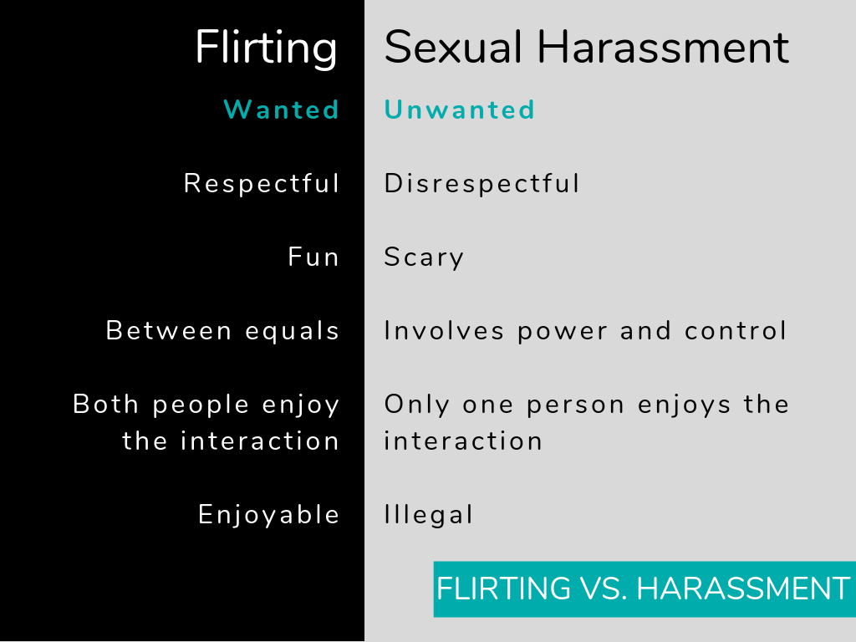
Notes:
The common factor is that one party is experiencing the event as unwanted and the other party doesn’t realize this. When we talk about sexual harassment, it is impossible not to address the sexist assumptions that tell men they can touch women in ways they feel are harmless and be unaware of the feelings of the women they are touching.
Sometimes, people think they are flirting, but really, they are engaging in sexually harassing behavior. Flirting is enjoyable behavior that happens between two people that like each other and find each other attractive.
Flirting is wanted and sexual harassment is unwanted. You can never be 100% certain that flirting is wanted and therefore you should never flirt in the workplace.
Flirting is respectful and fun, sexual harassment is disrespectful and scary. You cannot assume the other person is enjoying your flirtatious behavior. You need to check with them, either by asking them or reading their body language to see how they feel.
Culturally what is viewed as flirting in one country, can be perceived as sexual harassment in another country. It is important that each person understands the comfort level of the other person involved in any interaction.

Slide 10
Notes:
When we live and work in another culture, we can accidentally behave in socially unacceptable ways. Pay close attention to the body language of the person you are interacting with. If they move away from you, if their face or body shows fear or tension, or if they stop responding to you and look away, immediately stop what you are doing. You should ask them if your behavior is making them feel uncomfortable. If they tell you that they are uncomfortable, stop what you are doing. Never argue with them or try to convince them to change their mind.

Slide 11
Click Here for Video
(Ctrl+Click to follow link)
Notes:
You will now watch a short video showing sexual harassment between two people who used to date. As you watch the video, pay attention to how Alex’s body language and tone of voice changes. Alex is showing her growing discomfort with Christian’s actions, long before she tells Christian directly that she is uncomfortable. Be sensitive to the people around you and always respect another person’s boundaries, even if you had a romantic relationship with that person before.

Slide 12
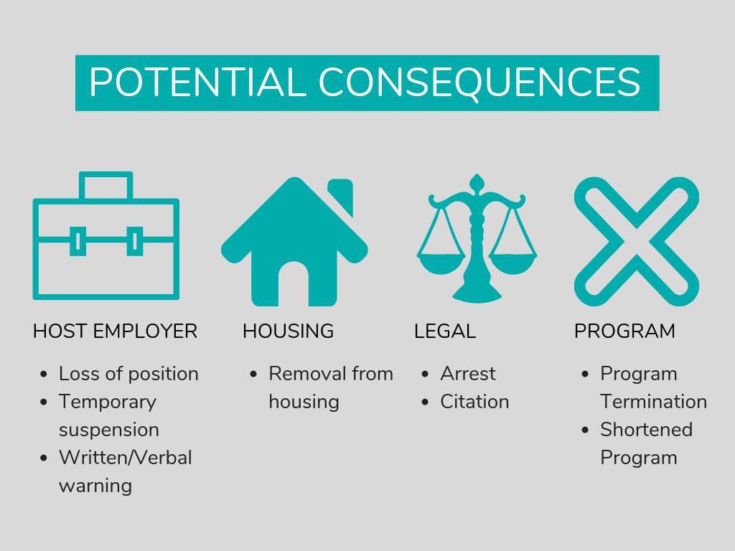
Notes:
As you can see, there were consequences for Christian when HR and his sponsor became involved. Consequences vary based on the type of act committed and the employer. If you are accused of sexual harassment, you may face consequences at work including a written warning, suspension or even losing your position. You may also face legal, housing or program consequences.

Slide 13
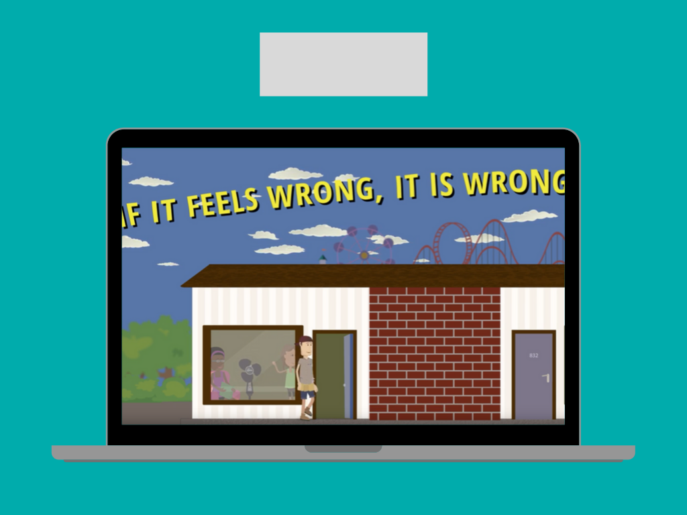
Click Here for Video
(Ctrl+Click to follow link)
Notes:
Now you will watch another video example of sexual harassment of a participant and her roommate in their housing. In this video, a maintenance worker touches a female participant without her consent. The participant’s roommate saw what happened and stepped in to help her.

Slide 14
Notes:
It was very important that Anastasia left her room when it started to become dangerous. Other safety tips include:
Do not be afraid to say STOP. Clearly state your concerns to those involved. You should not be afraid of any negative effect on your employment or program. Your program sponsor will help protect you.
Do not go out alone whenever possible. Bring a friend whether you are meeting a repairman in your housing, walking at night, or going to a party. If you have to go alone, make sure someone knows where you will be.
Lock your doors. Always protect against access by strangers whether it be in your bedroom, a car, or a workspace.
Travel Safely. Late night travel without a plan can be dangerous. Memorize your housing and host employer’s address and have a plan for safe travel to and from any destination.
Be cautious at social events. Do not accept open drinks and always go to parties with a friend.

Slide 15
Notes:
Here are some important steps you can take if you are experiencing sexual harassment. If you feel safe to do so, use your voice and your body to clearly tell the perpetrator STOP. Avoid being alone with the perpetrator. If you have any texts or emails between yourself and the perpetrator, save them and share them as part of your reporting. Write down all the details after an incident.
Tell a trusted friend or co-worker, inform your host employer and call your program sponsor, so that you do not have to handle this alone.
You can also contact an organization like RAINN that specializes in supporting those that have been sexually assaulted.
If the situation feels dangerous, remove yourself from a situation as quickly as possible and go somewhere safe. If necessary, call 911 for additional help.

