Slide 1
CIEE PRE-DEPARTURE ORIENTATION 2024
April 25, 2024

Slide 2
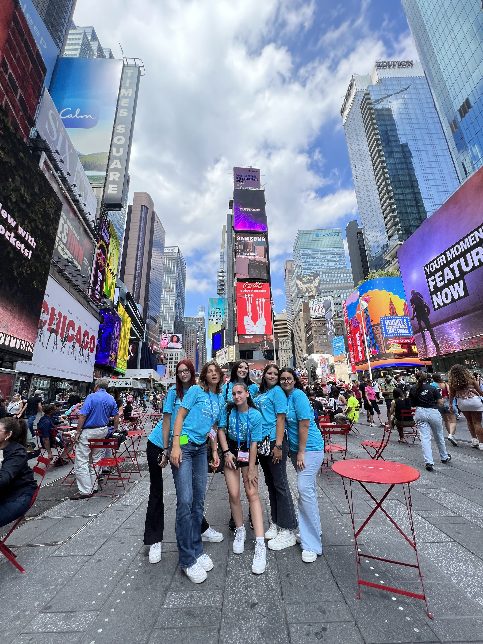
WHAT TO EXPECT:
About CIEE
Host Family and Community Life
School Life
Program Expectations
Program Rules
Questions/Comments

Slide 3
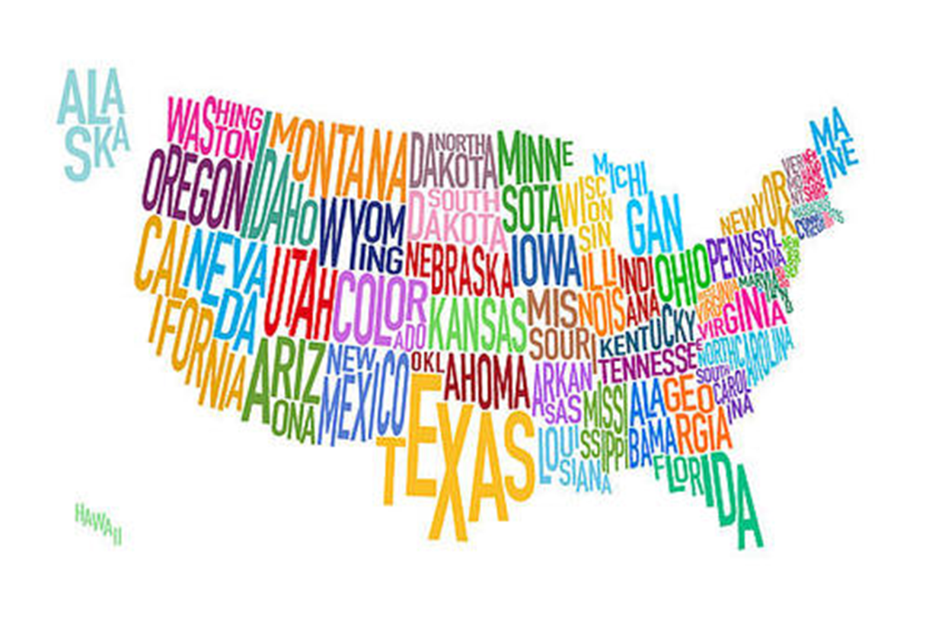
GET EXCITED!
In a few short months, you’ll be living with a host family in the USA!
Notes:
Ask if anyone has ever been to the US before? If so what state/s did you travel to?
Does anyone know where they are going to be living in the US?
Talk about how there are many different cultures in the US depending on what state they are placed in
Talk about weather in different regions
Can anyone point to the state where the CIEE Main Office is located?

Slide 4
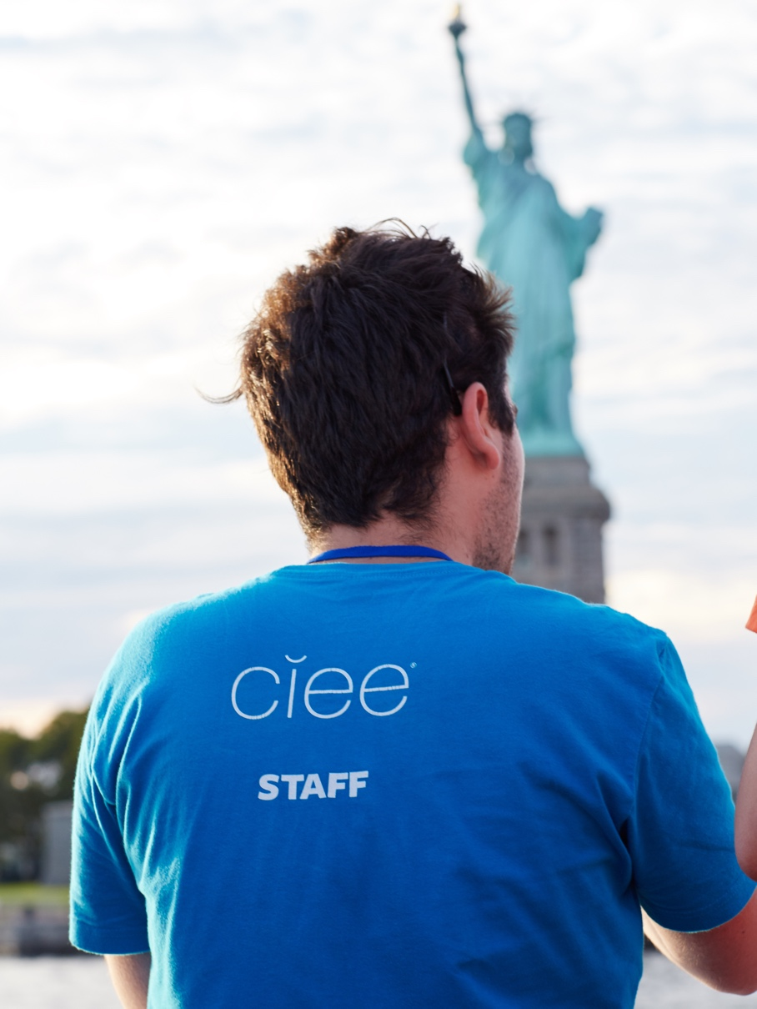
WHO IS CIEE?
Your program and J-1 Visa Sponsor
Assistance in the USA
Friendly, helpful staff
Available 24/7
1-800-448-9944

Slide 5
CIEE SUPPORT TEAM
Always remember
You can call CIEE at 1-800-448-9944
We’re here to support you this year!
Notes:
They can call CIEE anytime with questions or concerns
When you call you’ll need to tell us your US phone number. Also remember to respond to our emails and phone calls – requirement to stay in contact with Support
Quiz students on the 1-800-448-9944 number.

Slide 6
WHO IS YOUR HOST FAMILY?
Notes:
Host family - Now we’ll talk about host families! Is everyone excited to live with a host family for the year?
CIEE selects your host family and in some situations host families may change.
Diversity: Is there a “typical U.S. American family” ? No, all families in the U.S. are unique! Host families come in all sizes and live in many different locations. They come from different racial and cultural backgrounds. You might live with two host parents and host siblings, or you might live with one host parent, older or younger. It is important to accept your family for who they are just like you want them to accept you for who you are. Your host family might have a house in a city, or they might live in a smaller town. Some students think that they might not like their experience as much if they are living in a small town. But, if you live in a more rural community, you might be the first person they people have met from your country. You’ll be a star at your high school and in your town! People in your community will be very excited to meet you and learn about your experience, and you’ll have many opportunities to share your culture with them.
Welcome vs Permanent Families: Some of you might have a welcome family. What is the difference between Welcome and Permanent family? A welcome family is interested in hosting, but is not or cannot commit to hosting for the whole year. Your welcome family might turn permanent, or you might move to a new permanent family shortly after you arrive.
Rules and chores: Host families are as excited about international exchange as you are! Remember to be appreciative and respectful of your host family, their way of life, and their rules. You are a part of their household, so you are expected to do chores and help out as part of their family.
BIG TIP for SUCCESS! Remember to show your appreciation and courtesy by saying “please” and “thank you.”

Slide 7
WHO IS YOUR LOCAL COORDINATOR?
Notes:
Your Local Coordinator, also known as “LC” lives in your community and is there to Support you this year
They will check in with you at least once a month.
You can call them any time if you have any questions or concerns.
Even though they helped find your host family and school, their primary purpose is to support you.

Slide 8
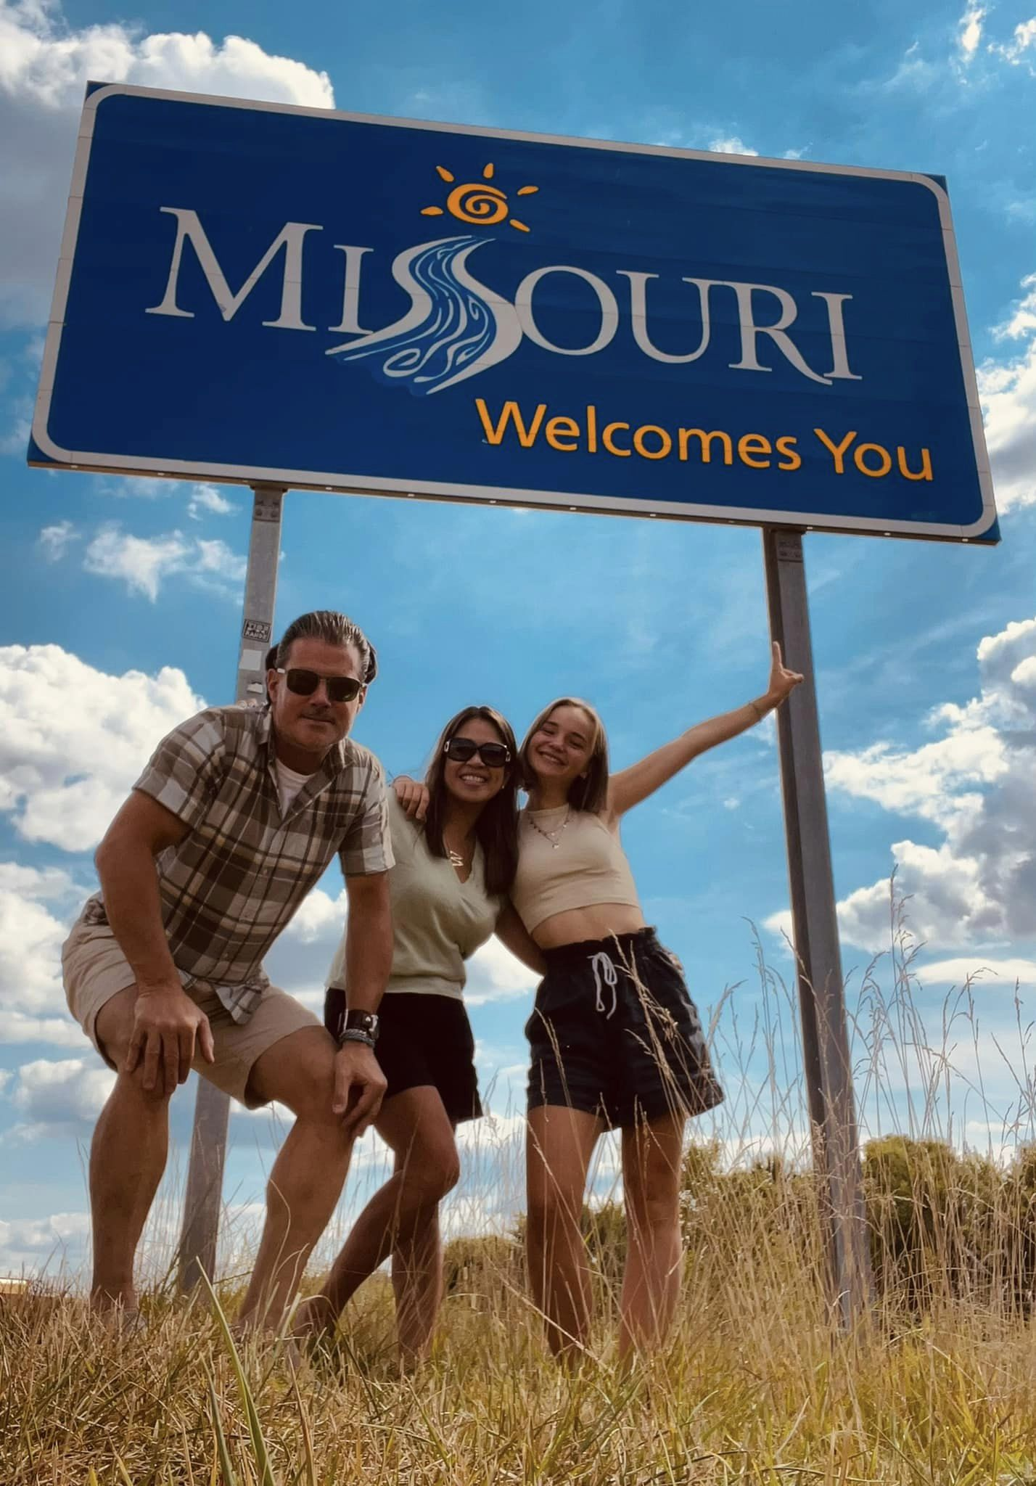
IN COMMUNITY ORIENTATION
Notes:
You’ll have an In-Community Orientation with your Local Coordinator soon after arrival
You will be picked up at the airport by your host family or local coordinator
We’ll send more information about your ICO before arrival!

Slide 9
YOUR COMMUNITY
Notes:
Rural Communities
Public Transportation: The US may not have as much public transportation available as in your home country but you have to be creative and resourceful! You can ask for a ride from your host family, your LC, your friends or from your friends’ families or you can get a bike or walk. You have to be proactive and be able to organize this.
Be open-minded – try to understand the differences in the US and accept them so you can fully immerse in the American culture.

Slide 10
YOUR SCHOOL
Notes:
School: Now let’s talk about your host school! Adjusting to a new school might be very challenging at first. It will take you a few weeks to get used to attending classes taught in English and to learn the customs of American high schools.
Choosing classes: At your high school, you’ll have certain classes that you are required to take, such as English and history. You’ll also be able to choose classes that you want to take, such as art, computer, or a gym class. Please note: All schools are different, and schools may not offer all of the same classes/extracurricular activities/sports.
Rules: Attendance is also very important. You cannot be late for school or classes, and unless you are very sick, you must attend school every day. Talk with your host family about your school’s rules regarding attendance. You are expected to obey all the rules like all the students in the school. Most schools also have a dress code, or rules saying what you can and cannot wear at your high school.
Ask for help: Your teachers will be important resources for you at your school. If you’re having trouble with a class or need a little extra help, your teachers will be there for you. Some teachers schedule special times when they are available to work one-on-one with students; ask your teachers if they do this! Some teachers also have student tutors who can help if you have a difficult assignment or if you’re preparing for a test.
Grades: Remember that one of the program requirements is to maintain a GPA above our minimum, so it’s important that you work hard in school. What is the minimum grade that CIEE expects? Answer: C+ average. If you’re having a tough time with any of your classes, talk to your teachers! Most teachers have taught international students before and will understand what you are going through. Speak up if you have any troubles; we want you to have a successful year!
It is normal for your schools to have ‘lock down’ drills – this is a protocol, just like fire drills, where you practice what to do in the case that a stranger enters the school. Try not to be frightened by this. Lock down drills are normal and are there for your safety.

Slide 11
CLUBS AND ACTIVITIES
Notes:
Activities:
There are also activities that you can participate in after school.
Many students play sports like football and track and join clubs like band and Key Club (for volunteering).
Every school has different clubs and activities; some clubs and activities may not be available at your school

Slide 12
WHAT WE EXPECT OF YOU!
Notes:
Share your culture, Be open-minded. Stay positive and give your best
Ask for help when you need it and communicate with host family, LC and CIEE Support Staff: Communication is the key. If there are issues talk with your host family and your Local Coordinator first, you can also contact your Support Coordinator. A lot of the issues result from misunderstandings – talk with your HF about any concerns so you can find solutions.
Be in the “learning zone” – new things, language, customs, perspectives. We’re here to support you when this learning gets tough!

Slide 13
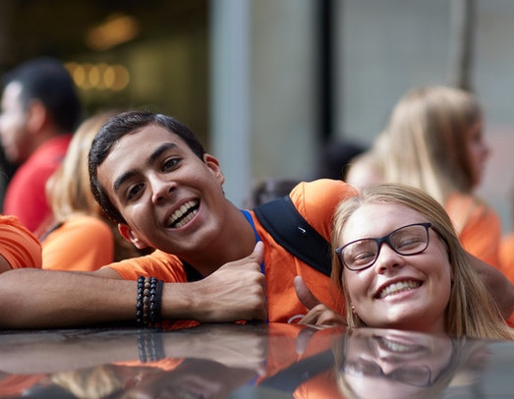
YOUR NATURAL FAMILY
Notes:
If you have a concern regarding an aspect of your child’s program, contact your home agency.
Allow time for your child to adjust and to develop a relationship with their Host Family. Students needs time to adjust to the new culture, find friends and develop relationships.
Limit communication: The best thing for your child’s experience is to give them some space to adjust to their new lifestyle in the US and build relationships
Help your child to budget their money
They’re in good hands!
Natural family visits: need CIEE Approval. No visits from friends, no natural family visits for 5-month students, no natural family visits for 10-month students until after January 1.

Slide 14
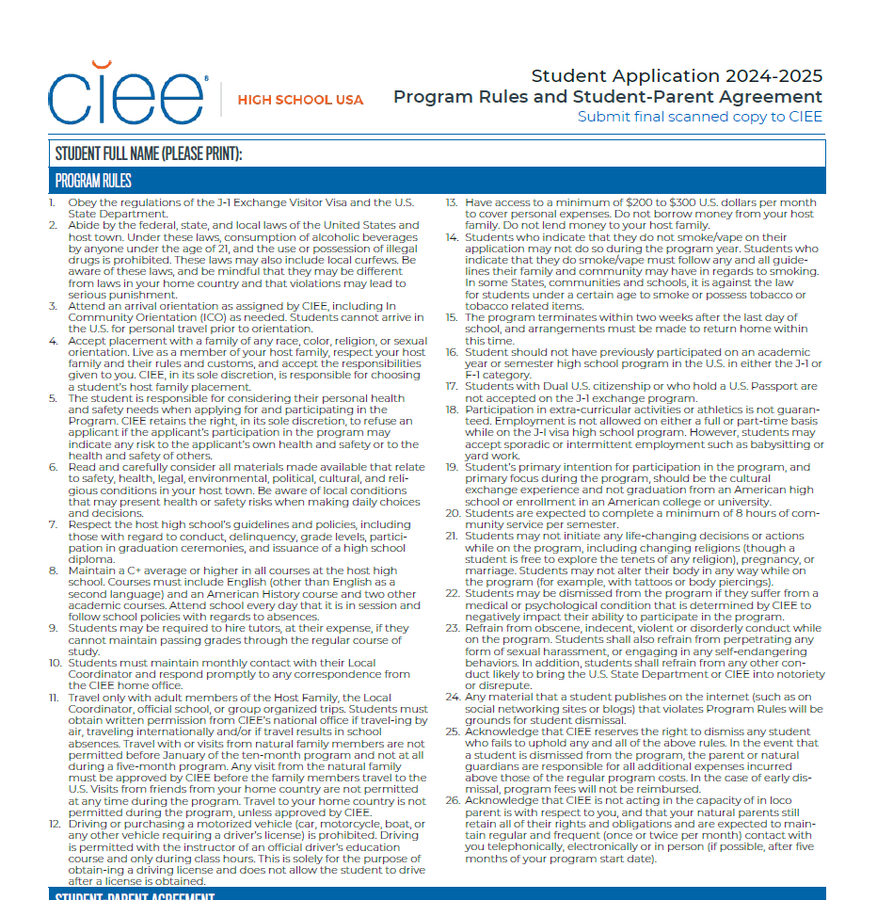
CIEE PROGRAM RULES
Notes:
Discuss disciplinary process – Warning, Probation, Dismissal (starting page 20 in the student handbook)
Steps to disciplinary process and some examples: behavioral issues, academic issues, lack of involvement with HF/school

Slide 15
GUN SAFETY
Notes:
Some American families have guns; some do not. Gun ownership is an important part of some families’ / communities’ cultures here in the USA, so it is quite possible that your host family will own guns. If your family has a gun, it may or may not be locked in a safe place. If you see a gun, DO NOT TOUCH IT! If you are feeling uncomfortable about having guns in the house, reach out to your host family, LC, and/or Support Coordinator.
Let your HF, CIEE Support, and LC know in advance if you plan to do anything gun-related. Your natural parents will need to sign a waiver before you can participate in any gun-related activity such as hunting or shooting.

Slide 16
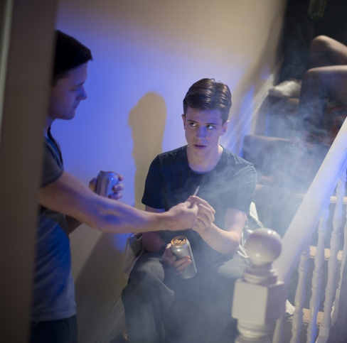
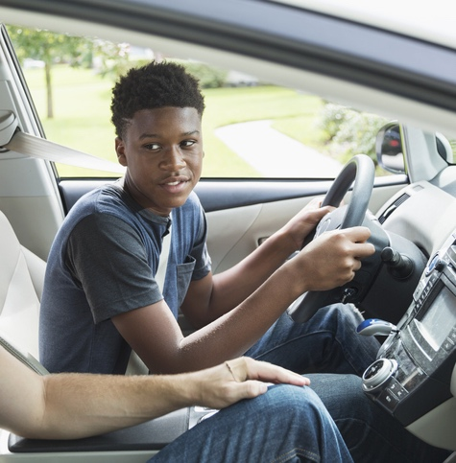
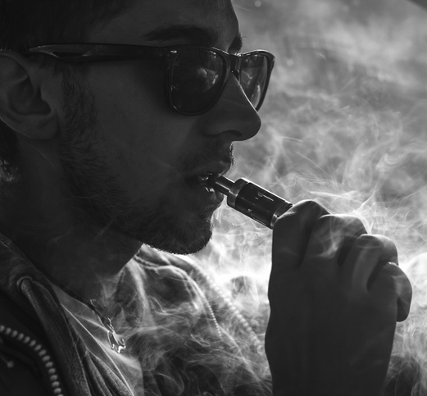
NO DRINKING, DRIVING OR DRUGS
Notes:
What are the 3 Ds? – there is no drinking, driving or drugs on program. Drinking and drugs are illegal for minors and may result in immediate dismissal from the program. Smoking cigarettes or e-cigarettes/vaping is not allowed on the program unless you are over 18 and previously stated on your app that you smoke. Even in that case, you must follow HF rules surrounding smoking.
Driving: Even though some of your classmates may be allowed to drive, CIEE does not allow exchange students to drive.
All three of these actions can compromise your safety, which is the #1 priority!
Ask students: ‘Do you have any questions about the 3 D’s?

Slide 17
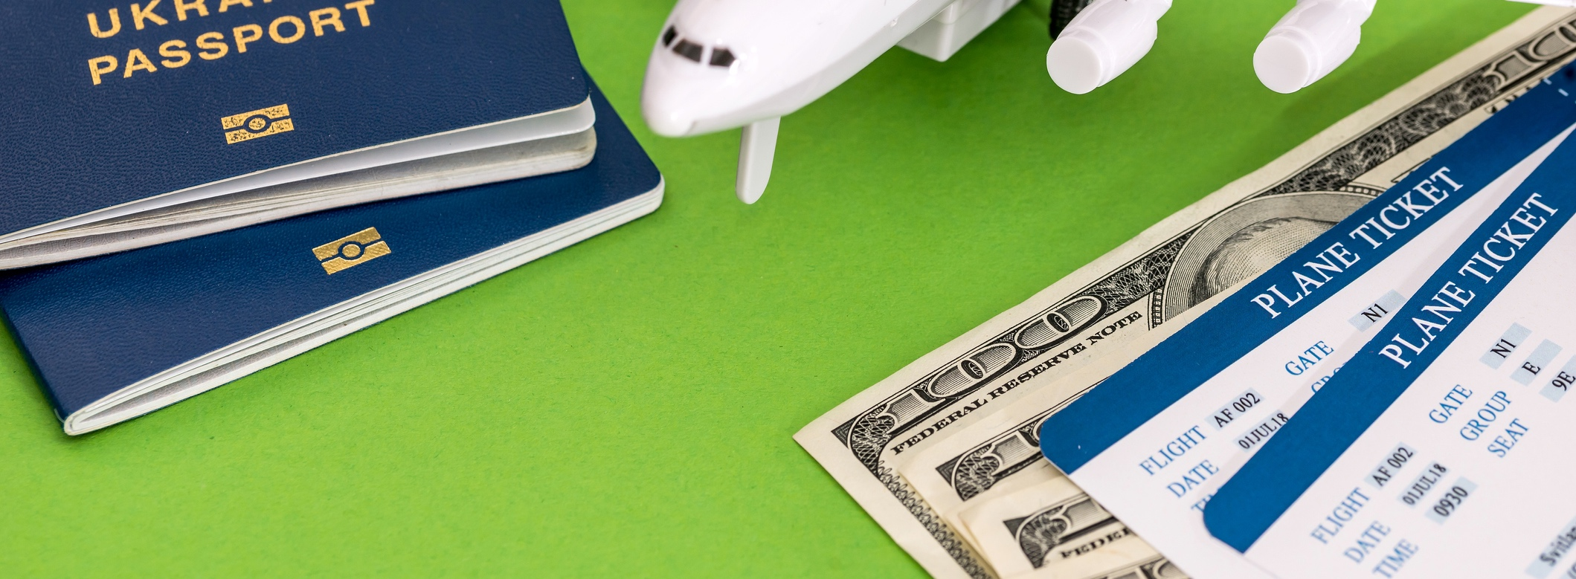
KEEP MONEY, PASSPORT, AND IMPORTANT DOCUMENTS SAFE
Notes:
Passport and other important documents: Keep your government documents in a safe place during your program year where you always have access to them. You must know where your documents are at all times and they should never be taken out of your possession. If your host family has a safe and you wish for them to keep your documents there, that is fine but you must have access to them any time you want.
Money: Carry only sufficient amounts of cash in a safe place, and do not ever show how much money you are carrying. How much money do you need to have access to each month?
Rule #11: a minimum of $150-$250. Make sure that your debit and credit cards work once you arrive in your host community.
KEEP MONEY SEPARATE!: Do not ever borrow money from or lend money to your host family, including bank accounts and cell phone plans. You are responsible for your money.
FYI: Your host family can monitor cell phone usage if you are on their plan
GET YOUR OWN CELLPHONE PLAN. Going on your HF’s plan can cause problems and is strongly discouraged.

Slide 18
INSURANCE CALL CIEE: 1-800-448-9944
Notes:
Mention co-pays.
Confirmation of Insurance Document (including insurance card) is available to download in Beacon
It is VERY IMPORTANT that you call CIEE before you go to the doctor. We will give you the information you need (which facility to go to and what you can expect to pay when you go).
Your insurance is designed to cover most illnesses and accidents but it does have some exclusions.
Physicals and immunizations are not covered

Slide 19
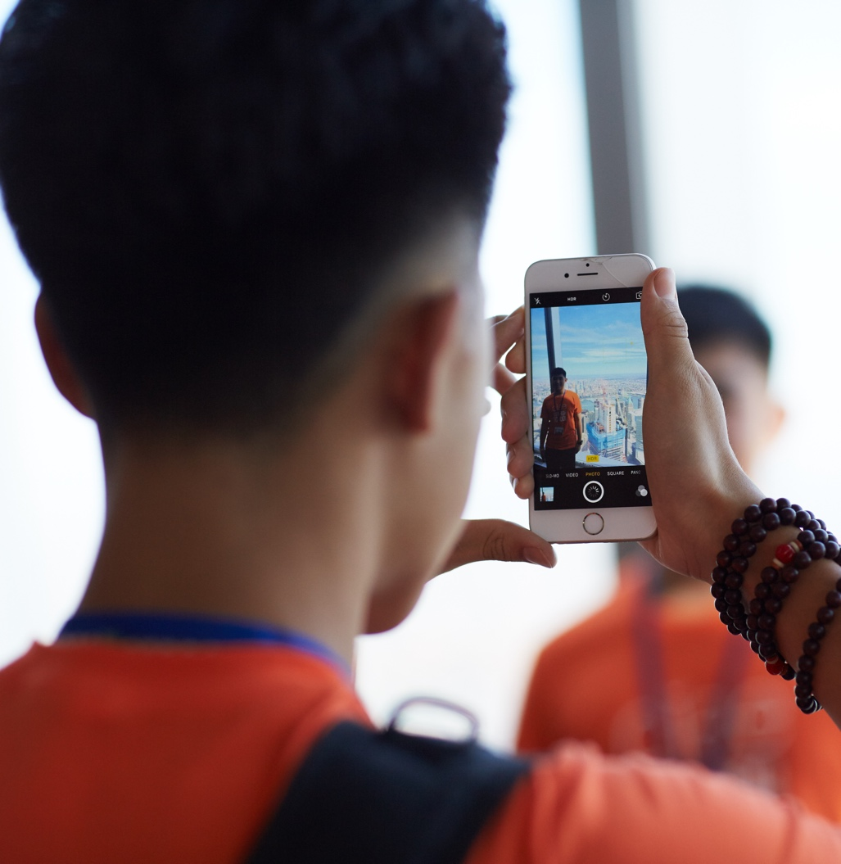
TECHNOLOGY + SOCIAL MEDIA
You are responsible for what you post on Social Media:
No posting inappropriate content
No bullying
No porn
Remember that anything you post
on the internet is public to everyone!
Notes:
Ask students: What is bulling? What is an example of bullying?
Avoid websites with pornography or excessive violence. Engaging in any type of pornography could be illegal. It’s extremely important that you understand how dangerous sexting, taking nude or sexual photos or videos, or visiting pornography sites can be. You could get in trouble with the law, you could get arrested, and you could cause harm to yourself or others.
In addition to possible legal problems, using a porn site will cause problems for your CIEE program and your host family.
Use good judgment when going online and be courteous and respectful of your host family and their rules.
Do not bully online or participate in any sort of online bullying.
Be careful what you text or post online in any language – anything you post on the internet or text someone could be public to anyone. We have students dismissed every year for things they have posted online or texted.
Schools DO NOT tolerate bullying. Bullying can lead to being expelled from school, and therefor dismissed from the CIEE program.
Remember, you may take the photo down, but that does not mean it will be erased.

Slide 20
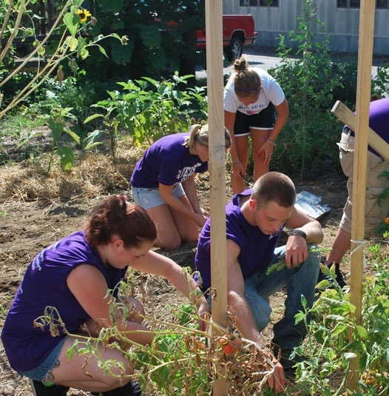
COMMUNITY SERVICE & GOAL FOR YOU: 20,000 HOURS!
What do you think community service is?
8 hours each semester
16 hours total
We invite and challenge you to get involved in your community and together work to submit 20,000 hours of service!
Notes:
All J-1 students are required to complete 8 hours of community service per semester – so 16 hours for the full year.
Community service is volunteer work meant to help people and places in your American home.
It’s a great way to better understand parts of life in your new community, and it’s a great way to help others.
It’s also a wonderful way to learn more about yourself by trying something new and focusing on something you might not otherwise focus on.
Emphasize the importance of conducting community service on a CIEE exchange program for both the participants and the community.
Underscore how community involvement enhances cross-cultural exchange, understanding and awareness.
Demonstrate the impact of exchange in American communities, thereby supporting one of ECA’s main goals.
Promote and teach the American value of community service and encourage exchange students to conceptualize and implement such programs in their home country.

Slide 21
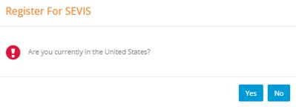
SEVIS REGISTRATION
Your DS-2019 Form was created in a system called Student and Exchange Visitor Information System
All J-1 exchange visitors are require to register in SEVIS after they arrive to the US
When you arrive to your host family’s home:
Log into your CIEE Beacon Application
Click the SEVIS Registration Button Pop-up
Verify your host family address & US phone number
Agree to CIEE program rules
Notes:
Talking Points:
Your Form DS-2019 was created in a computerized system known as the Student and Exchange Visitor Information System (SEVIS). This system is administered by the Department of Homeland Security and is used to collect and maintain information on the current status of non-immigrants and their dependents in the sponsor’s program during their stay in the United States.
All J-1 exchange visitors are required to register in SEVIS soon after they arrive in the US. You can easily register in SEVIS through your Beacon application by following these steps (no need to call to register anymore!):
Log into your CIEE Beacon Application. A “Register for SEVIS” pop-up will appear as soon as you log into Beacon. Please click "Yes" when you have arrived to your Host Family in the US.
Click the SEVIS Registration Button Pop-up. It will be an orange button which says “Complete Your SEVIS Registration”.
Your host family address & US phone number will populate. Please verify that the information is correct and make any necessary edits. Then click the blue “Confirm Address” button.
CIEE program rules will appear. Please review each rule and click the blue “Agree to Program Rules” button.
Once complete, a pop-up window will appear confirming that you have fully registered in SEVIS!
*Mention to students they will need to register ASAP when they arrive to their host families. Note they cannot register until they have physically landed in the U.S.

Slide 22
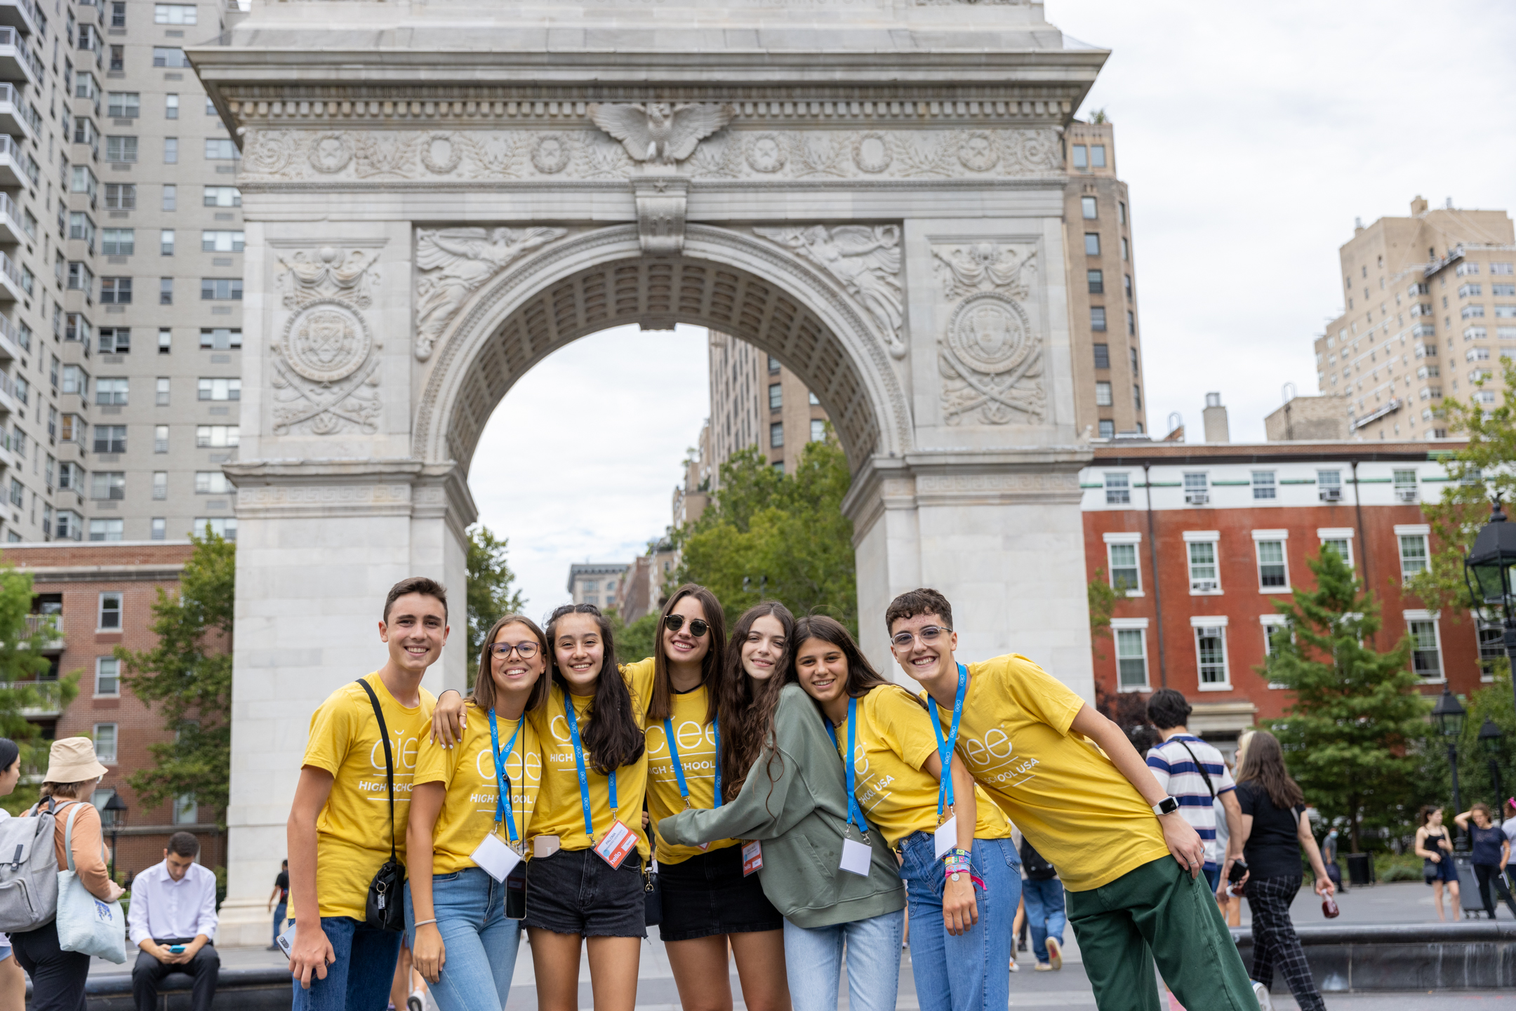
GOOD LUCK & HAVE FUN!

Slide 23
Questions?

