Slide 1
INVOICING & PAYMENTS
Thursday, January 30, 2020
International Representative Training
An Overview of the Finance Process

Slide 2
PROGRAM FEE INVOICING

Slide 3
PROGRAM FEE INVOICING STARTS IN BEACON
Program Fee Invoices are automatically generated according to the Elective Options in Beacon
If a student selects an option in Beacon, it will appear on their invoice
Please be sure to confirm that the elective options section in Beacon is correct
If a student has selected an option by mistake, or has changed their mind, please reach out to your Operations contact as soon as possible.

Slide 4
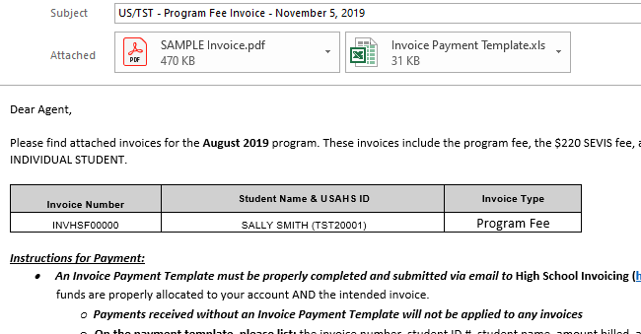
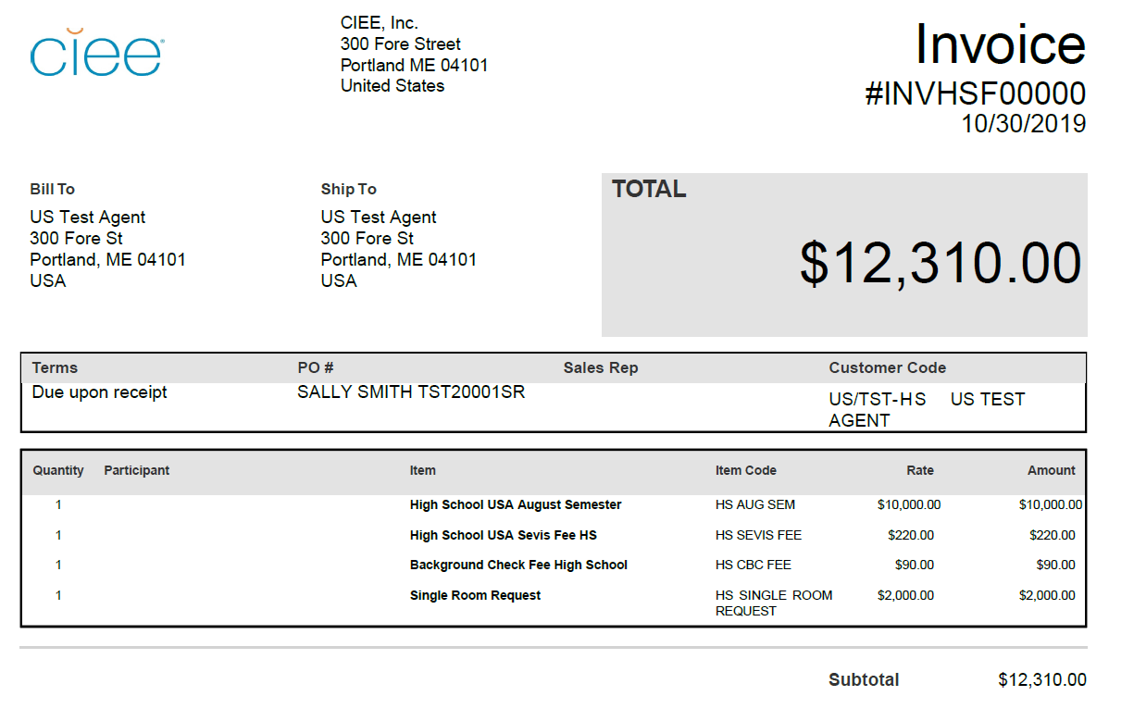
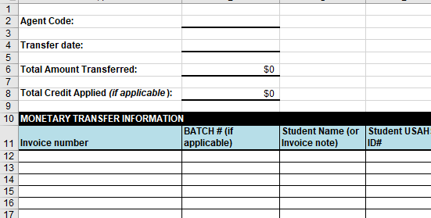
PROGRAM FEE INVOICES
Once the Program Fee Invoices are generated, your Operations contact will send your finance contact a notification email
This email will contain:
PDF copies of any program fee invoices for your agency
A blank Invoice Payment Template (IPT) Excel document
If the pricing does not match your Letter of Agreement, please contact your Sales or Operations contact

Slide 5
ANATOMY OF A PROGRAM FEE INVOICE
The header will include the Document Type (Invoice), Invoice Number, and date of generation
The total will appear in the grey box
The invoice is broken down into several line items
Program Fee (Semester or Year)
SEVIS Fee
Background Check Fee
Any elective options will appear as separate line items

Slide 6
PROGRAM FEE INVOICES CONTINUED
Included on the Program Fee Invoice are two fees that are considered
non-refundable,
even in the case of a cancellation.
If you have any questions regarding these fees, please reach out to your Operations or Sales contact.
SEVIS Fee
HS SEVIS FEE on invoice
This is the fee assessed by the United States for the issuance of a J-1 visa.
CBC Fee
HS CBC Fee on invoice
This fee covers costs associated with student placement.

Slide 7
PROGRAM FEE PAYMENT

Slide 8
PROGRAM FEE PAYMENT
Tips from our Finance Team:
Please write your agent code or a student USAHS ID in the comments on the remittance. This will help our Finance Team quickly identify the payment and apply it to your account
It is not required to send a receipt of the wire transfer with the Invoice Payment template, but it is helpful.
Please note that it can take anywhere from several days to a week for payment to reach our account
When submitting payment, please remit to the account at the bottom of the Program Fee Invoice
Prior to, or the same day as each transfer, please send your Operations contact a completed Invoice Payment Template
Please copy HS-Invoicing@ciee.org on this email
A blank IPT form will be attached to the Program Fee Invoice email from your Operations contact.
If you are sending payment in multiple wire transfers, please submit a new IPT for each wire transfer
Please ask your Account Specialist if you have any questions

Slide 9
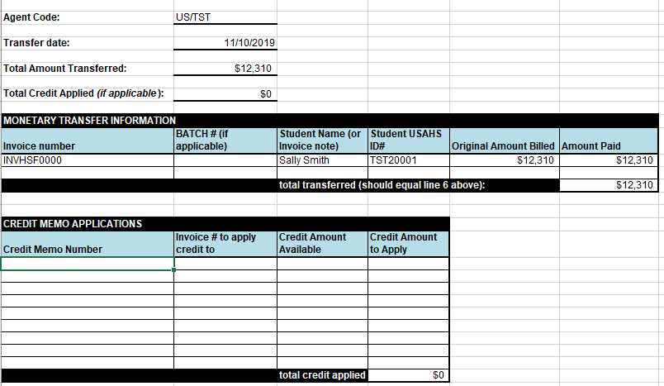
ANATOMY OF AN INVOICE PAYMENT TEMPLATE
Please include your agent code and transfer date
The total amount transferred will automatically fill from the spreadsheet
Enter the Invoice Numbers to be covered by the payment, as well as student names and USAHS IDs
BATCH # can be left blank
If the payment will cover multiple invoices, please enter each on their own line
If you are applying credit memos to the payment, please provide all the information requested

Slide 10
PROGRAM FEE PAYMENT
DS-2019 forms will not be shipped until all program fees and past due balances are paid
Each Invoice should be paid in full in one transfer
Payment for a Pending Student does not guarantee acceptance
We strongly discourage partial payments of invoices, especially Program Fee Invoices
If partial payment is unavoidable, please be sure to clearly indicate it on the Payment Information Form
CIEE will not ship a DS-2019 form for a partially paid student
If a fully paid student is not accepted on the program, fees will be refunded according to the terms of the Letter of Agreement
Operations can not ship the forms until all fees are paid, but we can provide student DS-2019 numbers on request (for the purpose of scheduling a visa interview)
CIEE will cover the cost of one DS-2019 shipment, but forms can be shipped in multiple shipments on request

Slide 11
MISCELLANEOUS INVOICES & CREDIT MEMOS

Slide 12
INVOICES CAN BE GENERATED FOR OTHER REASONS
Additional Student Expenses
Agency Expenses
These are expenses tied to a single student
For example:
These are expenses that are generated on a wider level.
For example:
Additional elective options*
Copays
Travel expenses
*Must be paid before the DS-2019 is shipped
Airport Transfer Fees for multiple students
Additional DS-2019 shipments

Slide 13
CREDIT MEMOS
Credit Memos are used to add credit to your account
During the fiscal year, CIEE may issue credit memos to you
Some credit memos are not issued until after the student has traveled to the US.
Credit Memos will appear as a general credit on your account, but can also be applied to specific invoices on request
If you would like to use a credit memo on an invoice, please indicate so on an Invoice Payment Template and send it to your Account Specialist
If you are applying credit memos to a payment, please provide all the information requested on the Invoice Payment Template
Please note:
CIEE can not wire a credit balance to your bank account until after our finance reconciliation in the fall.

Slide 14
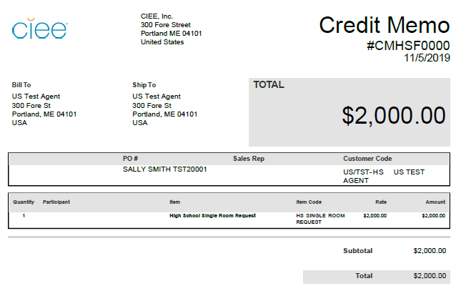
ANATOMY OF A CREDIT MEMO
The header will include the Document Type (Credit Memo), Number, and date of generation
The total will appear in the grey box
The Credit Memo will show the credit as a positive number
In this example, a credit is being issued for a student who is dropping their Single Room Request

Slide 15
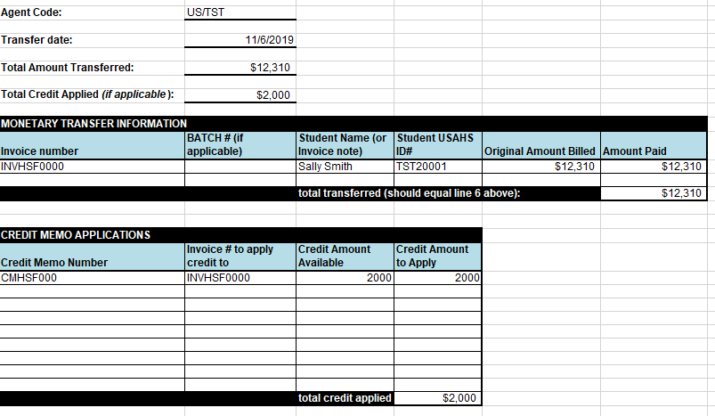
INVOICE PAYMENT TEMPLATE WITH CREDIT MEMO
Please include the invoice number to apply the credit to
This is listed in the Credit Memo section

Slide 16
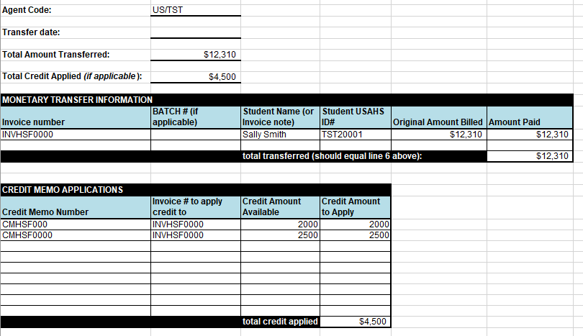
INVOICE PAYMENT TEMPLATE WITH CREDIT MEMO
It is possible to apply multiple credit memos to one invoice
Please enter the invoice number in both rows

Slide 17
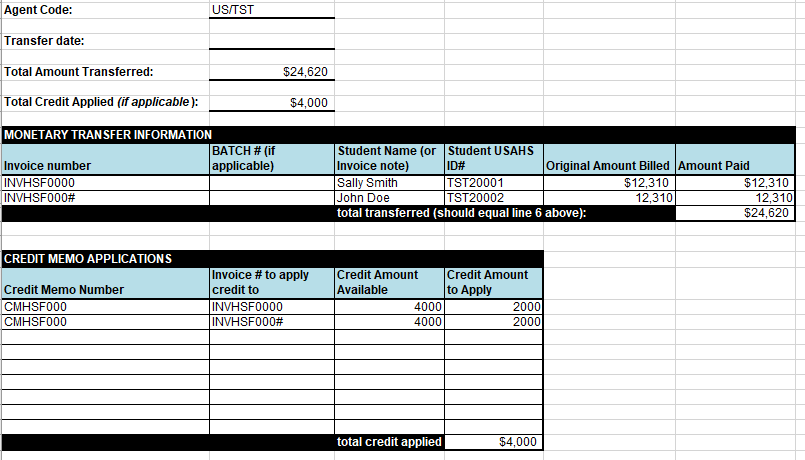
INVOICE PAYMENT TEMPLATE WITH CREDIT MEMO
It is also possible to apply one credit memo to multiple invoices
Please list each invoice on its own row in the Credit Memo section
This is most useful if the credit memo can fully cover one or more invoices

Slide 18
QUESTIONS…?
Your Account Specialist is here to help!
HSOps@ciee.org
The Operations team
HS-Invoicing@ciee.org
Please copy on invoicing and finance related questions
CIEE Portland – headquarters 300 Fore Street Portland, ME 04101 1-800-40-STUDY
Annie Hooper
Manager
International
Operations
Eve Schultz
Senior Account Specialist
Melissa Chase
Account Specialist
Amelia Devine
Account Specialist
Justin Waligory
Account Specialist
Emily Pakulski
Account Specialist

Slide 19
THANK YOU!

